Slide 1
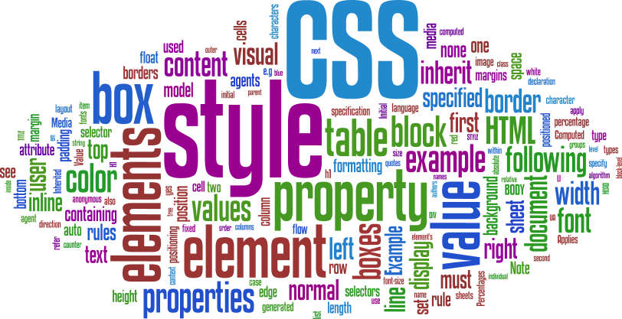

Slide 2
CSS
INTRO
index.html
CSS File
about.html
contact.html
A single Cascading Style Sheet file can control the color typography and layout of multiple web pages

Slide 3
CSS
HISTORY
First proposed by Håkon Wium Lie on October 10, 1994
CSS1 released in Dec 1996 – along with Bert Bos
CSS2 released on May 12, 1998 – by the CSS Working Group
CSS3 still under development

Slide 4
CSS
“CASCADING”
Browser Defaults
Embedded Styles
Inline Styles
External (Imported) Styles
Contained in the body of HTML page
Contained in the <head> section of the HTML page
“style” attribute
Separate text file with .css extension
<style> element
Applies only to the specific element
<link> element in the head section provides the URI to the .css file.
Applied to the entire web page

Slide 5

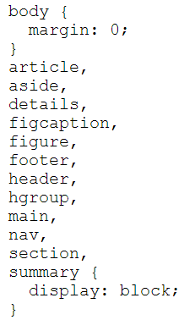
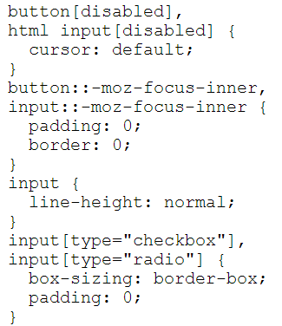
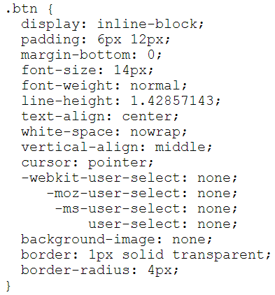
CSS
SYNTAX
SELECTOR
HTML Element Name (just name)
Class Name (“.” + name)
Id Name (“#” + name)

Slide 6
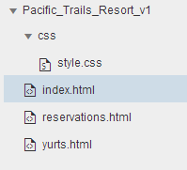
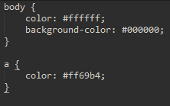
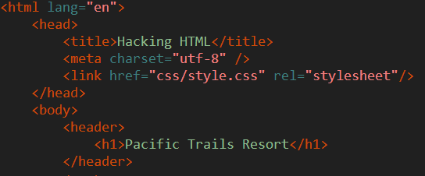
CSS
CSS COLOR
<link href="css/style.css" rel="stylesheet"/>
Change text color to White (#ffffff)
Change Background color to Black (#000000)
Change hyperlink color to Pink(#ff69b4)
Always placed in the header section
TEST
Try using inline/embedded CSS style attribute for the elements!

Slide 7
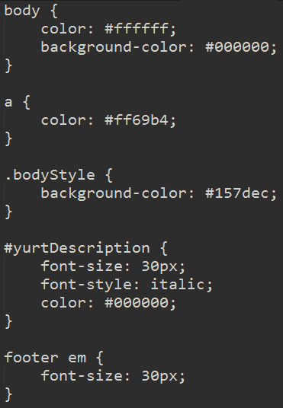
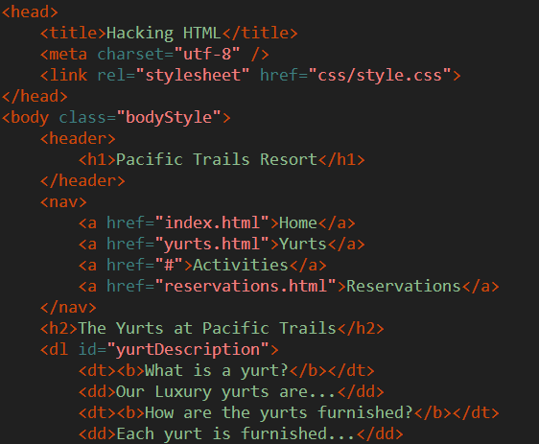
CSS
CLASS / ID SELECTORS
Add Id/Class attributes to elements within yurts.html
“Cascading” witnesses by overriding styles within a css document
Id user more for JS, Class used more for CSS
New font styles introduced
Descendant Selectors – footer > em

Slide 8
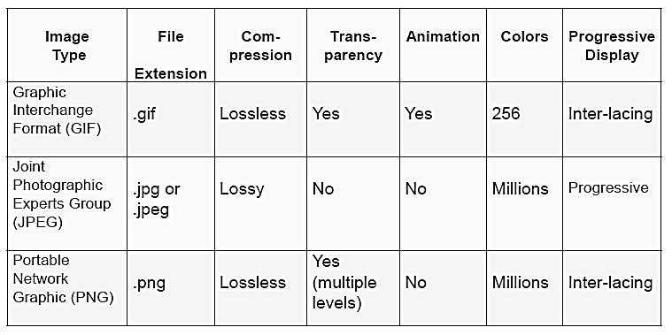
CSS
WEB GRAPHICS

Slide 9
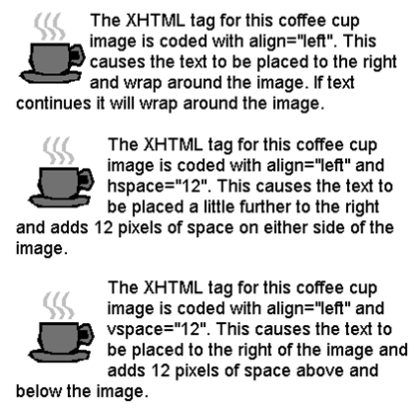
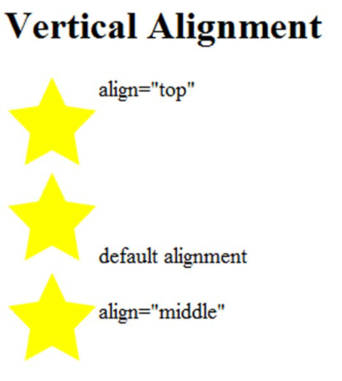
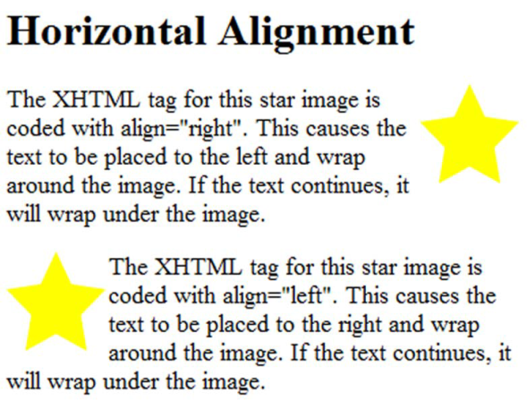
CSS
WEB GRAPHICS
File URI
Height of graphic in pixels
<img src=“cake.png” alt=“birthday cake” height=“100” width=“100”>
Alternate text description (e.g. for disabled people)
Width of graphic in pixels
Align = ?
<img> align attribute
hspace attribute
vspace
attribute

Slide 10
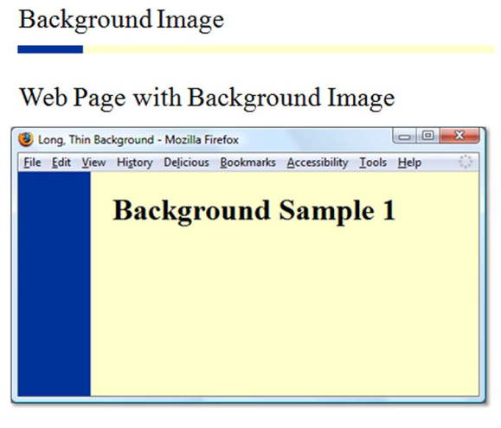
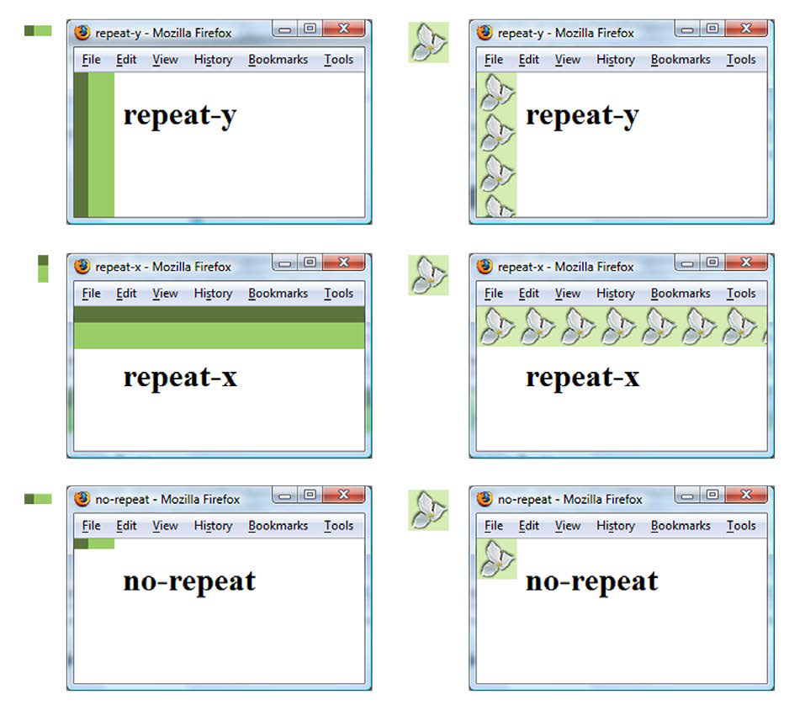
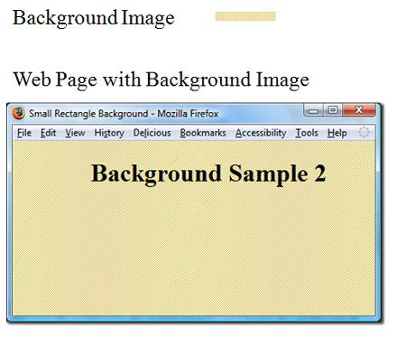
CSS
CSS PROPERTIES - BACKGROUND
body {
background-image: url(background.png);
background-repeat: no-repeat;
}
* By default images tile (repeat)

Slide 11
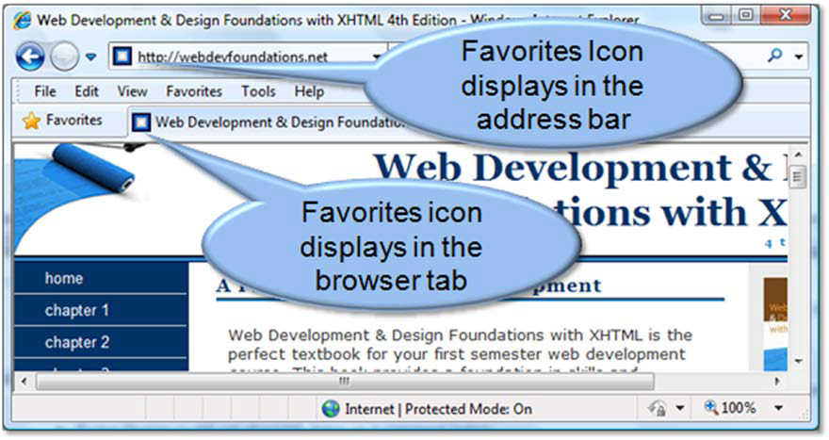
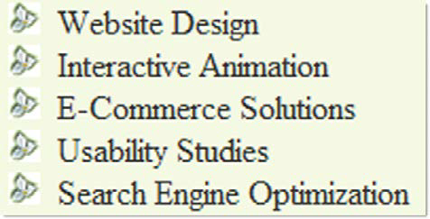
CSS
CSS PROPERTIES -
FAVORITES ICON / LIST MARKERS
ul {
list-style-image: url(flower.png);
}
<link rel="icon" href="favicon.ico" type="image/x-icon" />
* Generally of size 16px x 16px

Slide 12
CSS
CSS FONT PROPERTIES
font-family | Arial | Helvetica | sans-serif (can be other font families. last is the fallback)
font –size | 90% OR 35px (can be given as % or pixels)
font-weight | bold | bolder | light | lighter | normal | inherit | 100-900 (in increments of 100)
font-style | normal | italic | oblique
@font-face | font-family | src (e.g. something like url(webfont.woff))
line-height | normal | 3.5 (relative to element’s font size) | 3em | 34% (relative to element’s font size)
text-align | start | end | left | right | center | justify | match-parent | start end
text-indent | 3mm | 30px | 15% (relative to element’s font size) | each-line | hanging
letter-spacing | normal | initial | inherit | 3mm | 3px
width | auto | inherit | 100% | 200px | 30em
height | auto | inherit | 100% | 200px | 30em
Notes:
@font-face allows you to load web fonts instead of just relying on the system fonts installed on a machine.

Slide 13
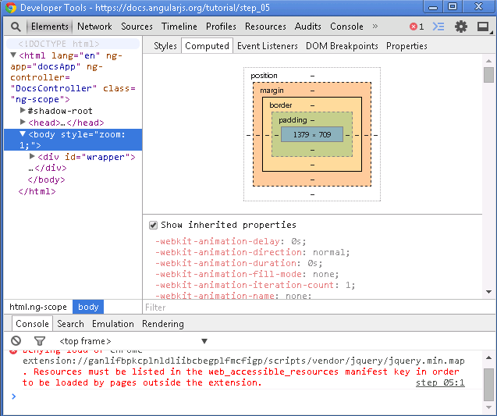
CSS
BOX MODEL
Content
Padding
Border
Margin
Top/Bottom/Left/Right

Slide 14
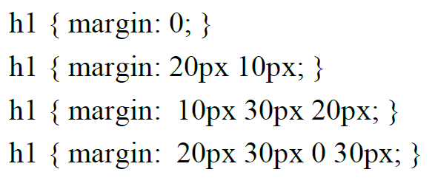
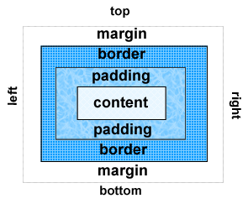
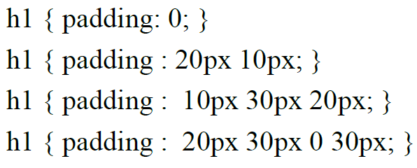
CSS
MARGIN / PADDING
Clockwise property: top right bottom left
Notes:
=

Slide 15
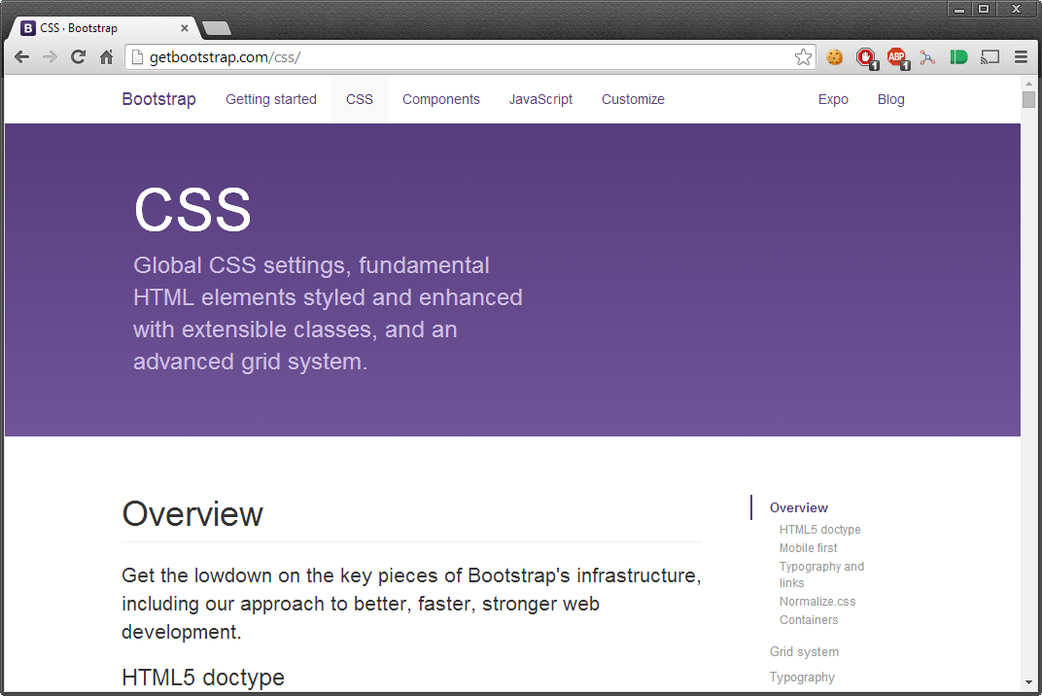
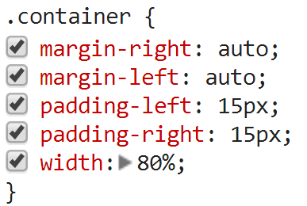
CSS
PAGE CENTERING

Slide 16
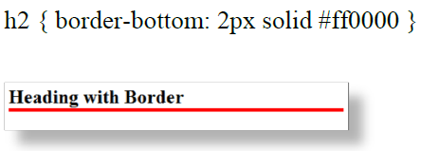
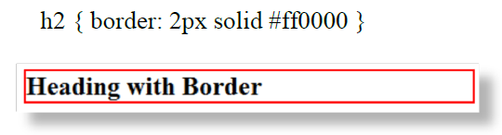

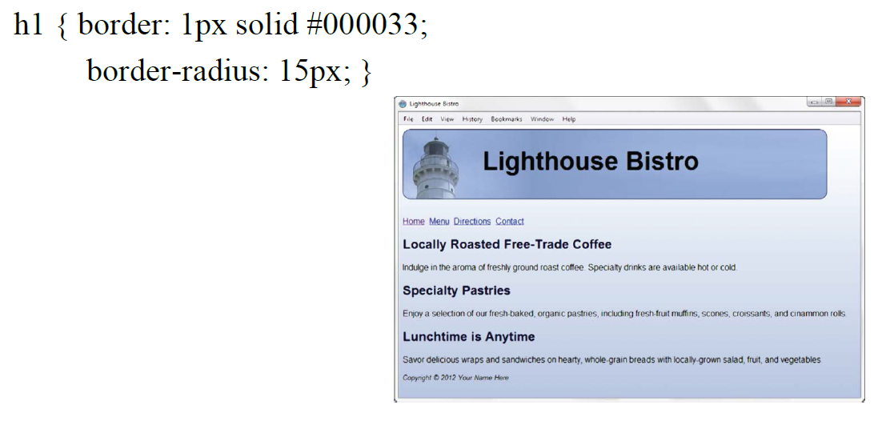
CSS
BORDER

Slide 17
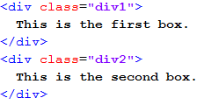
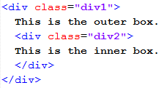
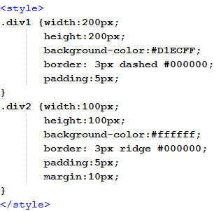
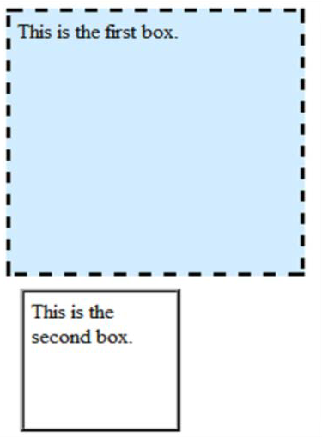
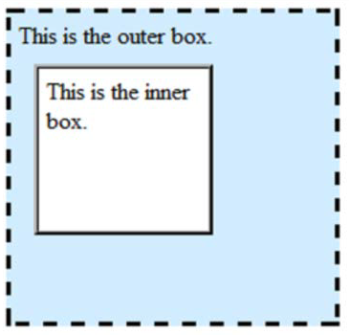
CSS
PAGE LAYOUT (BASIC)

Slide 18
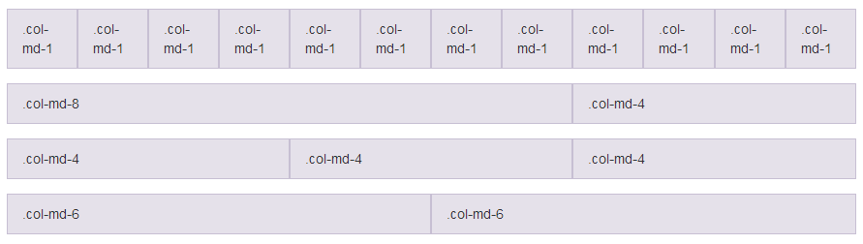
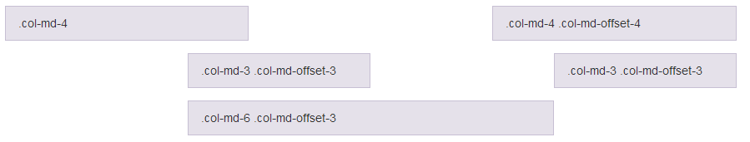
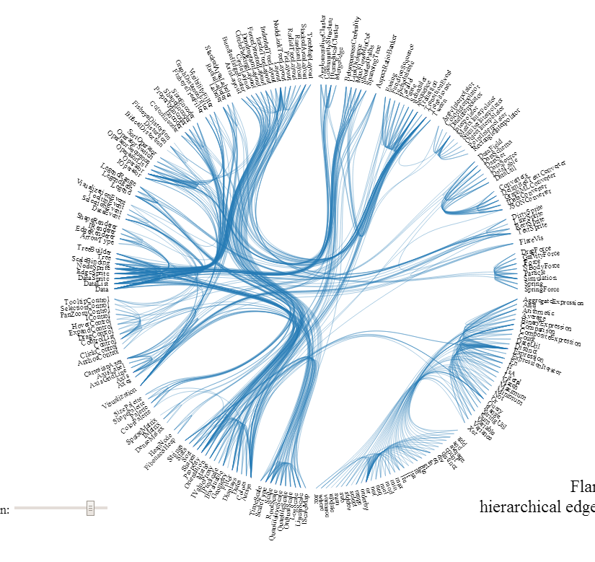
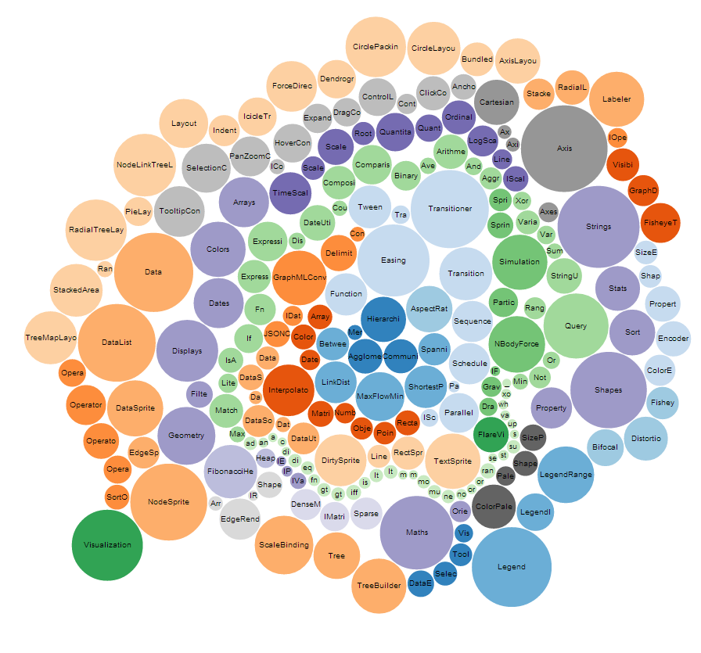
CSS
PAGE LAYOUT (ADVANCED)
GRID LAYOUTS
Bootstrap
Foundation
NON-GRID LAYOUTS
D3.js

Slide 19
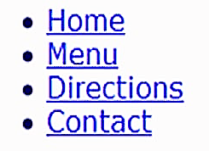

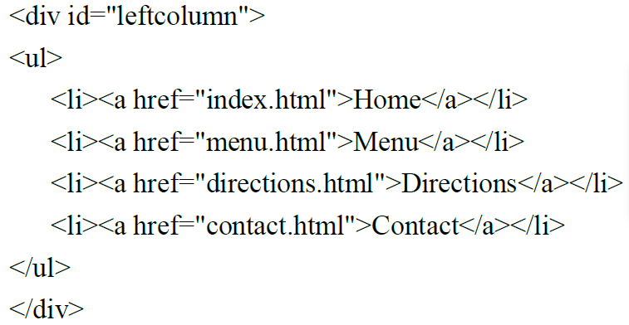
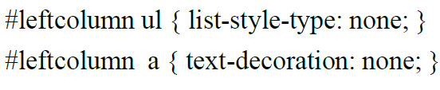


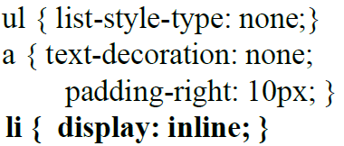
CSS
NAVIGATION
Remove list dots and text underline

Slide 20
CSS3

Slide 21
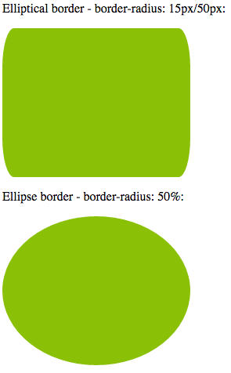
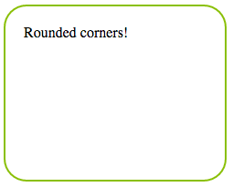
CSS3
ROUNDED BORDERS
#corners {
border-radius: 25px;
}
Applied in the order: top-left , top-right, bottom-right, bottom-left

Slide 22
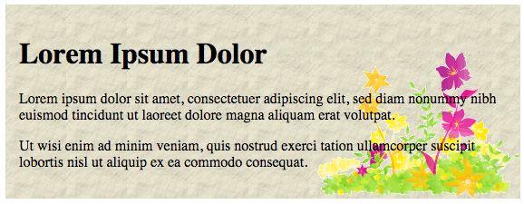
CSS3
EXTRA BACKGROUND
Multiple background images
Background sizes (Height-Weight, cover, contain)
Background origin
Background clip
#example1 {
background: url(img_flwr.gif) right bottom no-repeat, url(paper.gif) left top repeat;
}
http://www.w3schools.com/css/tryit.asp?filename=trycss3_background-clip

Slide 23
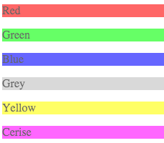
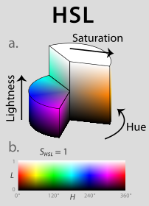
CSS3
EXTRA BACKGROUND
HSL/HSLA colors – hue, saturation, lightness, alpha – cylindrical color system
RGBA colors – red, green, blue, alpha
opacity
#p1 {background-color:rgb(255,0,0);opacity:0.6;}
#p2 {background-color:rgb(0,255,0);opacity:0.6;}
#p3 {background-color:rgb(0,0,255);opacity:0.6;}
#p4 {background-color:rgb(192,192,192);opacity:0.6;}
#p5 {background-color:rgb(255,255,0);opacity:0.6;}
#p6 {background-color:rgb(255,0,255);opacity:0.6;}

Slide 24
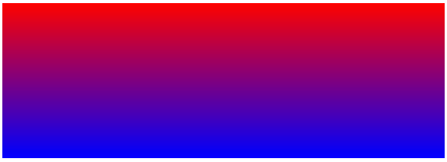




CSS3
GRADIENTS
Linear
Radial
background: linear-gradient(direction, color-stop1, color-stop2, ...);
background: radial-gradient(shape size at position, start-color, ..., last-color);
default direction is “top to bottom”
default, shape is ellipse, size is farthest-corner, and position is center
background: linear-gradient(to bottom right, red , blue);
background: radial-gradient(red, yellow, green);

Slide 25

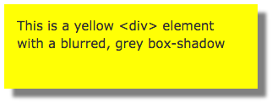
CSS3
SHADOW EFFECTS
text-shadow
box-shadow
Order of definition: horizontal-shadow, vertical-shadow, blur-size, shadow-color
h1 {
text-shadow: 2px 2px 5px red;
}
h1 {
box-shadow: 10px 10px 5px grey;
}

Slide 26
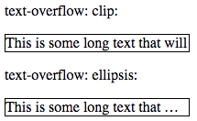
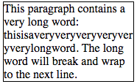
CSS3
TEXT
div.test {
text-overflow: clip;
overflow: hidden;
white-space: nowrap;
}
text-overflow
div.test:hover {
text-overflow: inherit;
overflow: visible;
}
p.test {
width: 11em;
border: 1px solid #000000;
word-wrap: break-word;
}
word-wrap

Slide 27
CSS3
FONTS
@font-face {
font-family: myFirstFont;
src: url(sansation_light.woff);
}
div {
font-family: myFirstFont;
}

Slide 28
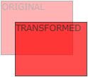



CSS3
2D TRANSFORMS
translate()
rotate()
scale()
skewX()
skewY()
matrix()
div#myDiv {
-ms-transform: rotate(20deg); /* IE 9 */
-webkit-transform: rotate(20deg); /* Safari */
transform: rotate(20deg); /* Standard syntax */
}

Slide 29



CSS3
3D TRANSFORMS
div {
-webkit-transform: rotateX(150deg); /* Safari */
transform: rotateX(150deg);
}
rotateX()
rotateY()
rotateZ()

Slide 30


CSS3
TRANSITIONS
div {
width: 100px;
height: 100px;
background: red;
-webkit-transition: width 2s; /* Safari */
transition: width 2s;
}
div:hover {
width: 300px;
}
http://www.w3schools.com/css/css3_transitions.asp

Slide 31
CSS3
ANIMATIONS
Hardware Accelerated using the GPU
Changes many CSS properties together at once into another
@keyframes: specifies the animation code
animation-duration: time taken for one animation cycle
animation-name: name of the @keyframes animation
animation-timing-function: speed curve of an animation
h1 {
animation-duration: 3s;
animation-name: slidein;
}
@keyframes slidein {
from {
margin-left: 100%;
width: 300%;
}
to {
margin-left: 0%;
width: 100%;
}
}
http://www.w3schools.com/css/css3_animations.asp

Slide 32


CSS3
The viewport is the user's visible area of a web page
VIEWPORT
<meta name="viewport" content="width=device-width, initial-scale=1.0">

Slide 33

CSS3
GRID VIEW
* {
box-sizing: border-box;
}
[class*="col-"] {
float: left;
padding: 15px;
border: 1px solid red;
}
.col-1 {width: 8.33%;}
.col-2 {width: 16.66%;}
.col-3 {width: 25%;}
.col-4 {width: 33.33%;}
.col-5 {width: 41.66%;}
.col-6 {width: 50%;}
.col-7 {width: 58.33%;}
.col-8 {width: 66.66%;}
.col-9 {width: 75%;}
.col-10 {width: 83.33%;}
.col-11 {width: 91.66%;}
.col-12 {width: 100%;}

Slide 34
CSS3
RESPONSIVE IMAGES
img {
width: 100%;
height: auto;
}
img {
max-width: 100%;
height: auto;
}
If the max-width property is set to 100%, the image will scale down if it has to, but never scale up to be larger than its original size

Slide 35

CSS3
MEDIA QUERIES
@media only screen and (max-width: 500px) {
body {
background-color: lightblue;
}
}
@media only screen and (orientation: landscape) {
body {
background-color: lightblue;
}
}

